Slide 1





VBF and VBS Measurements in ATLAS
Zhen Wang
2024/July/10
PASCOS 2024

Slide 2
01.
Motivation
04.
Signal extraction
02.
Background
05.
Unfolding
03.
Observation
06.
Summary

Slide 3
Motivation

Slide 4
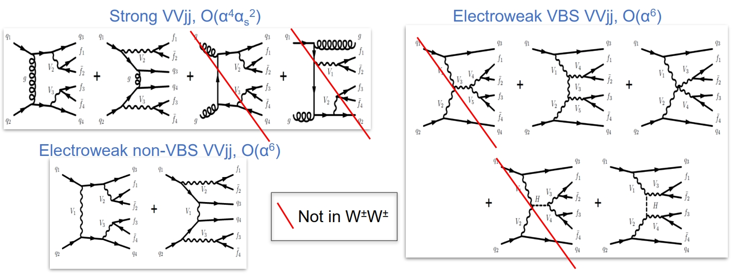

Same-sign $W^{±}W^{±}jj$
Motivation:
Massive vector boson scattering (VBS) probes mechanism of electroweak symmetry breaking (EWSB) in the Standard Model (SM)
Unique sensitivity for new physics phenomena
$W^{±}W^{±}jj$ final states has largest EW to QCD xsection ratio because of the suppression of QCD-induced background
EW measures both VBS and non-VBS process, inclusive measurements include EW + QCD + interference

Slide 5
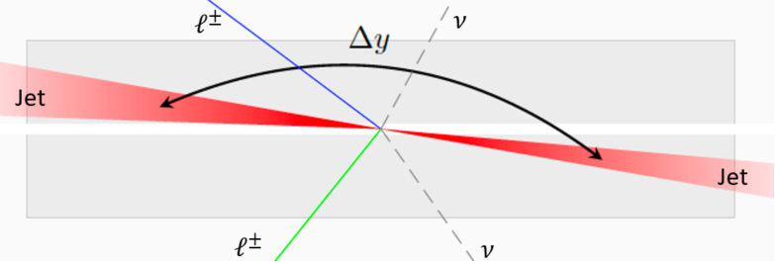
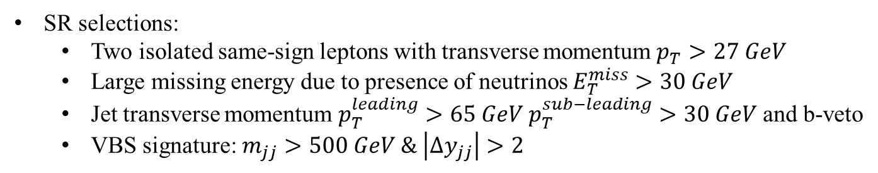
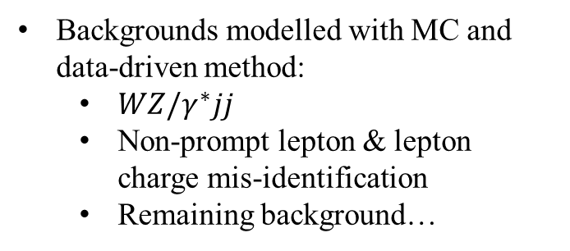

Same-sign $W^{±}W^{±}jj$ Strategy
SR selections:
Two isolated same-sign leptons with transverse momentum $p_{T}>27 GeV$
Large missing energy due to presence of neutrinos $E_{T}^{miss}>30 GeV$
Jet transverse momentum $p_{T}^{leading}>65 GeV p_{T}^{sub−leading}>30 GeV$ and b-veto
VBS signature: $m_{jj}>500 GeV \& \left|Δy_{jj}\right|>2$
WZ CR (improve modelling from QCD-induced $W^{±}Zjj$ events):
One more lepton with $p_{T}>15 GeV$
$m_{jj}>200 GeV$ & $m_{lll}>106 GeV$(suppress radiative Z decay)
Low-$m_{jj}$ CR (control uncertainties of major background in signal extraction fit):
$200 GeV<m_{jj}<500 GeV$
Backgrounds modelled with MC and data-driven method:
$WZ/γ^{∗}jj$
Non-prompt lepton & lepton charge mis-identification
Remaining background…

Slide 6
Same-sign $W^{±}W^{±}jj$ Fiducial Cross Section
SR selections:

Slide 7
Differential ZZjj

Slide 8
Opposite-sign WWjj

Slide 9

VBS $Wγ$ jj

Slide 10

VBS $WZ$ jj

Slide 11
Summary
All non-prompt backgrounds have been investigated with validated data-driven methods
Observed EWK Wyjj production with 8.96(9.16) σ based on Sherpa(Madgraph) templates
Differential cross section measured for 6 variables
Set limits on 16 dimension-8 EFT operators

